Slide 1
UCF Autonomous Carrier Assistant
Group 5
Amine Chahli
Richard Garces
Muhammad Khan
Hunter Busa
Final
Presentation

Slide 2
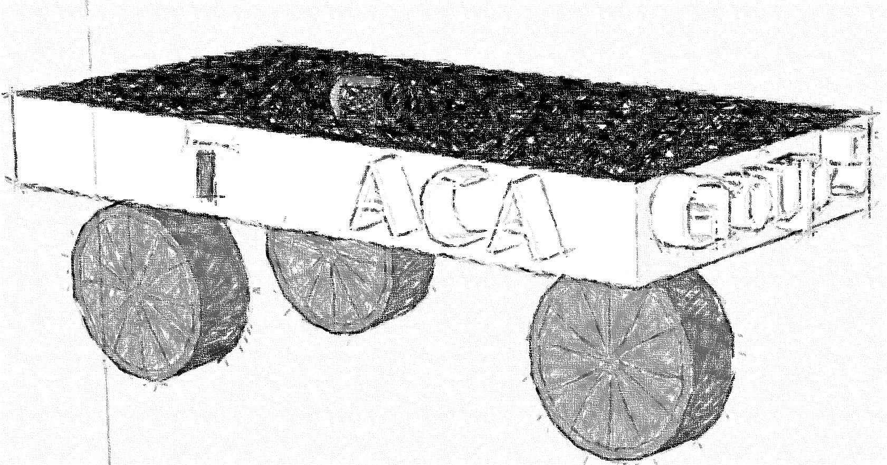
Content List
Project Objective / Goal
Requirements / Specification
Components
PCB
Budget / Finance
Work Distribution

Slide 3
ACA Platform

Slide 4
Goals and Objectives
Hunter Busa
One of our goals is to have the Autonomous Carrier Assistant follow the user autonomously.
The ACA will be able to autonomously lead the user to the Waypoints.
Joystick is optional when GPS connectivity is low.
The ACA should provide convenience for the user by carrying their items.
An easy to use mobile app will be implemented to control the ACA by the user.

Slide 5
Specification/Requirements
Richard Garces
Specification | Requirement | Target
Collision detection | Detect objects and redirect or stop | 2-4ft
Follow consumer | Follow consumer at a consistent distance | 2-5 ft
Lead Consumer | Go to Designated Way-Point | To get with in 5-10 feet to the way-point
Joystick Controller | Joystick can also be used to drive the ACA | Go Anywhere you want to with out GPS connectivity or transmission errors
Battery Power | Provide enough battery life to complete consumers needs | Up to 3 hrs.
Mobile App | Connect to a mobile device quickly | Max 15 secs

Slide 6
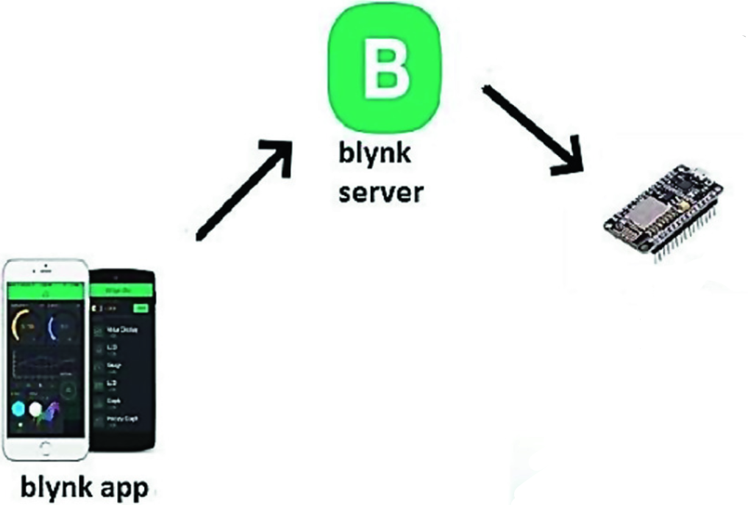
BLYNK Mobile Application

Slide 7
Components

Slide 8
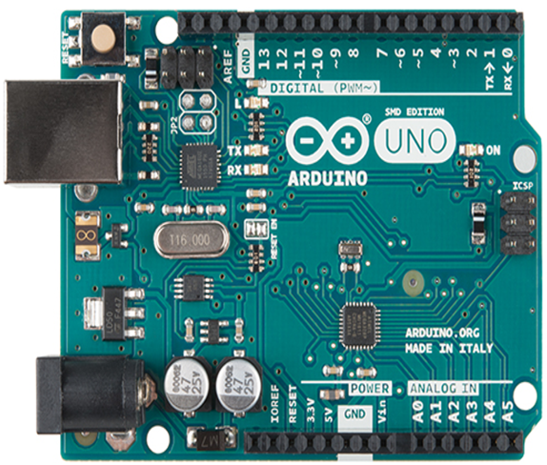
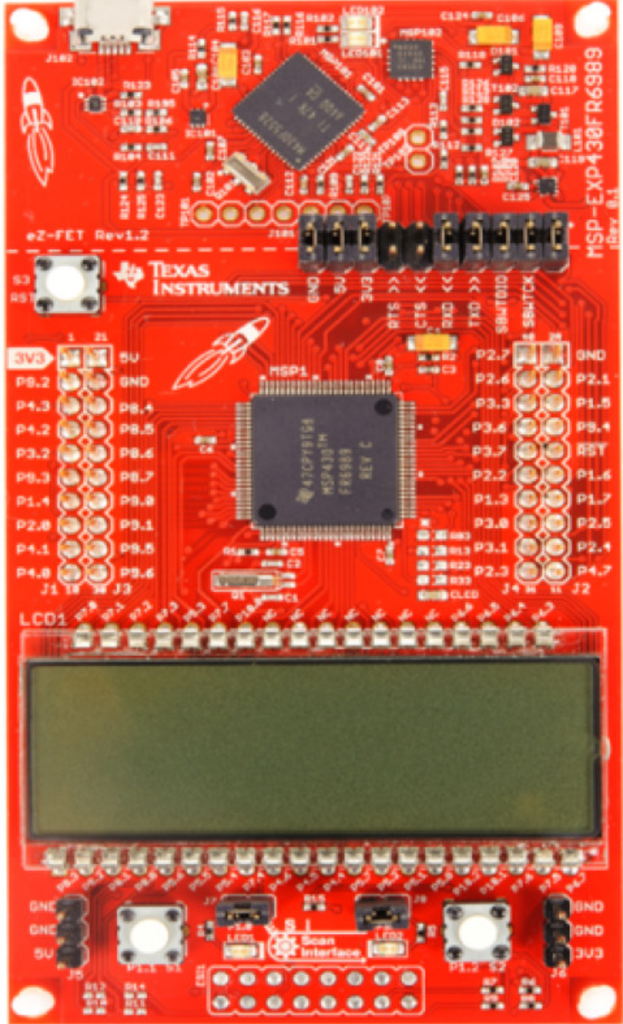
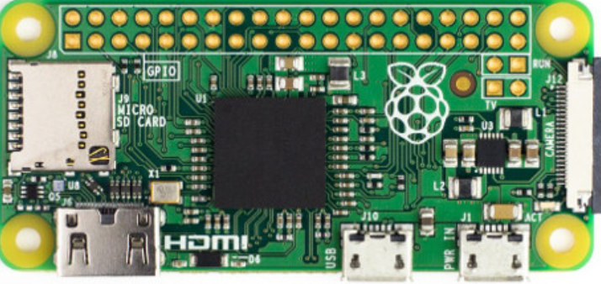
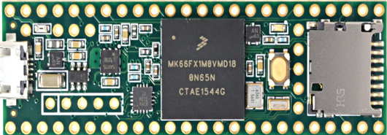
Micro-controller Options
Richard Garces

Slide 9
Micro-controller Comparison
Richard Garces
Development board | Arduino uno Rev 3 | Raspberry Pi Zero | MSP 430RF6989 | Teensy 3.6
Microcontroller | Atmega328P | BCM2835 | 430RF6989 | MK66FX1mo
Cost | $2.08 | $5.00 | $3.30 | $17.65
Architecture | 8-bit | 32-bit | 16-bit | 32-bit
Clock | 20Mhz | 1Ghz | 16Mhz | 180Mhz
Operating Voltage | 1.8-5.5V | 1.8-3.3V | 1.8-3.6V | 1.71-3.6V
Power Consumption | 200uA/Mhz | 100mA | 100uA/Mhz | 90mA

Slide 10
MCU Selection Arduino Uno Rev 3
Richard Garces
Popularity – There is a lot of information available
Ease of Use – User friendly IDE does not require high level knowledge
Community – Lots of hobbyist use Arduino
Resources – YouTube, online forums, Articles, Libraries

Slide 11
Coding with Arduino
Richard Garces
The IDE is Written in JAVA
The actual coding is done in C++
Due the popularity and resources many codes exist
Use existing codes and Tweak them to reach our requirement and specifications

Slide 12
Motor Comparison
Muhammad Khan
DC Motor | AC Motor
Higher starting torque | lower power demand on start and minimal maintenance
Quick start, stop, & reverse | Less efficient
Variable speeds with voltage input | Poor positioning control
Easier and affordable to control than AC | challenging to find AC solutions with fractional horsepower ratings

Slide 13
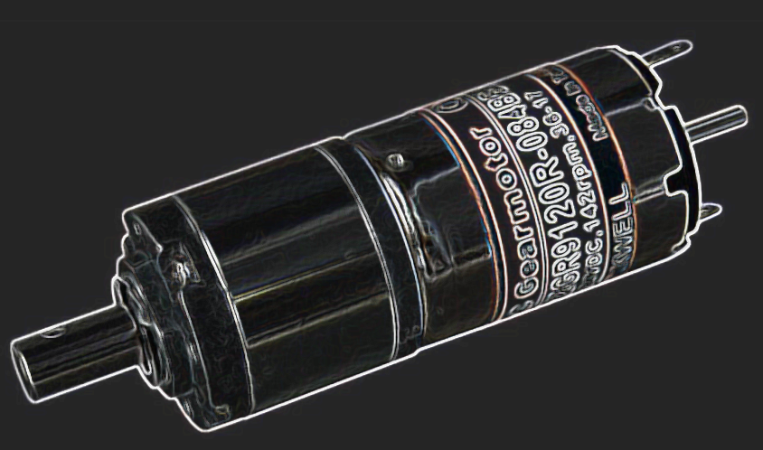
DC Gear Motor BY KENNWEL
Muhammad Khan
Specifications:
Wide operating range, 6-24Vdc.
Dual ball bearings.
Rated 142RPM @ 24Vdc
Shaft diameter 6mm
Overall length of motor and gearbox 60mm.

Slide 14
Motor Driver Comparison
L298N | TB612FNG | L293D
Full H -bridge | Full H-Bridge | Half H-Bridge
4.5-35V | 2.5-13.5 | 4.5V-35
Can handle up to 4 Motor | Only handle 2 Motors | Can handle upto 4 Motor
Excellent Reviews | Fair Reviews | Decent reviews

Slide 15
Motor Driver L298N H-Bridge
Muhammad Khan
Specification
Dual H Bridge Motor Driver
L298N motor driver IC
Drives up to 2 bidirectional DC motors
Integrated 5V power regulator
5V – 35V drive voltage
2A max drive current

Slide 16
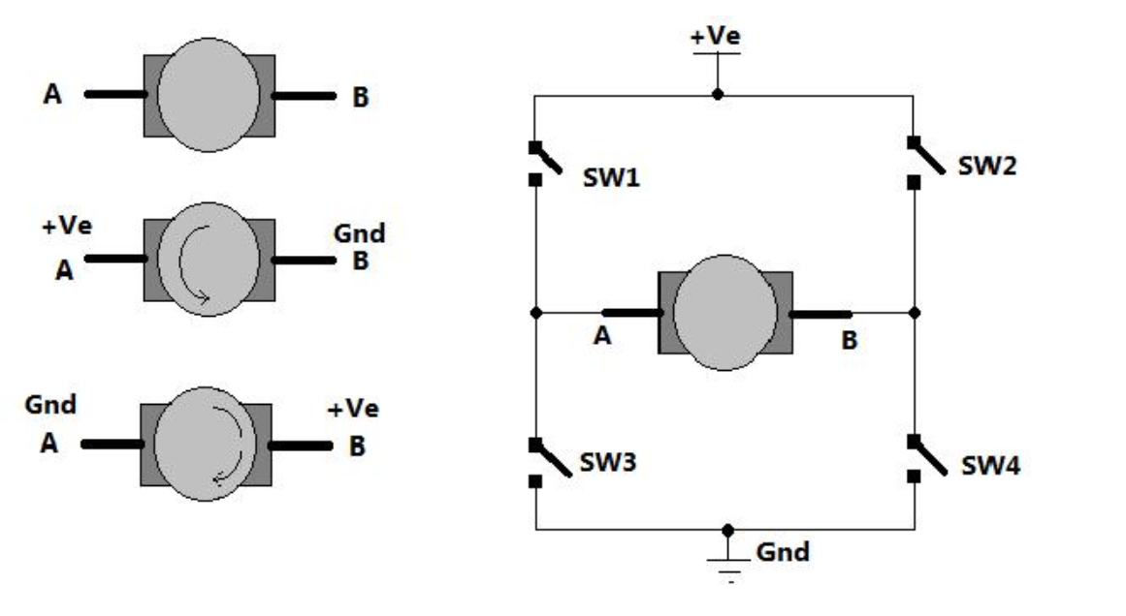
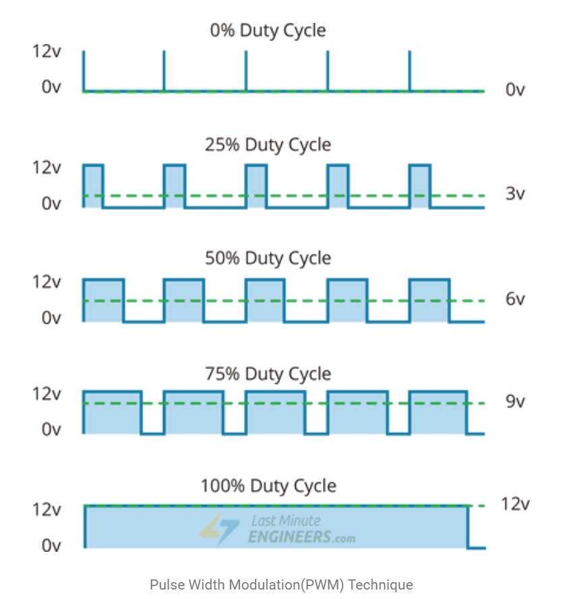
Dc motor Control with L298N H- Bridge PMW
Muhammad Khan
PWM – For controlling speed
H-Bridge – For controlling rotation direction

Slide 17
Muhammad Khan
The spinning direction of a motor can be controlled by applying either a logic HIGH(5 Volts) or logic LOW(Ground) to these inputs. The table illustrates how this is done.
Input1 | Input2 | Spinning Direction
Low(0) | Low(0) | Motor OFF
High(1) | Low(0) | Forward
Low(0) | High(1) | Backward
High(1) | High(1) | Motor OFF

Slide 18
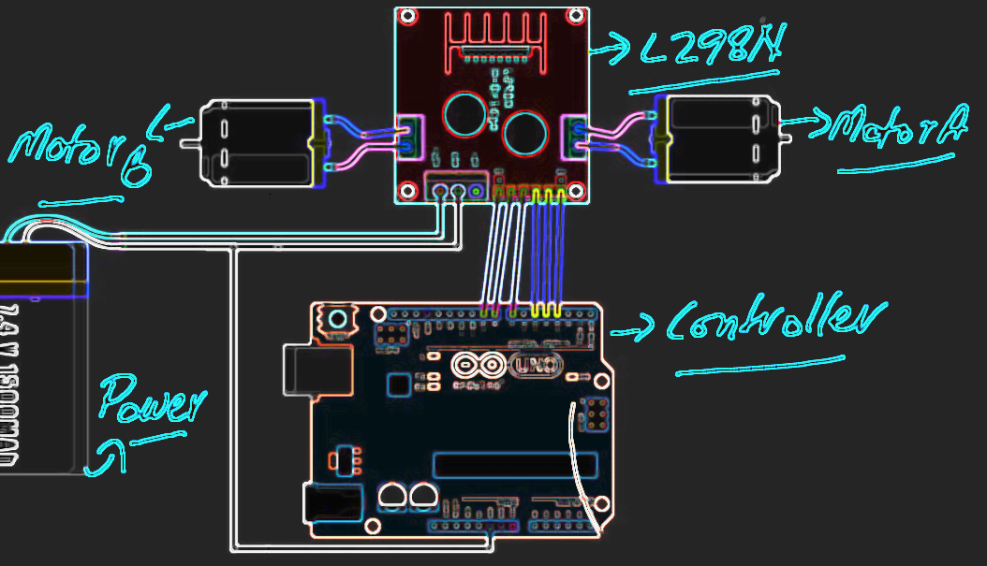
Motor Driver Setup
Muhammad Khan

Slide 19
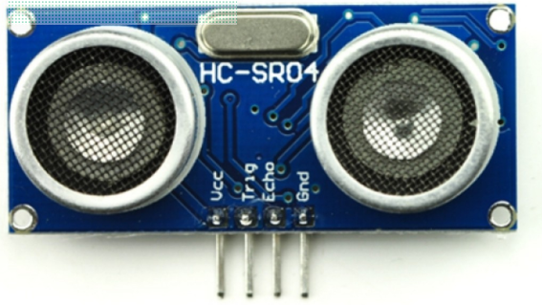
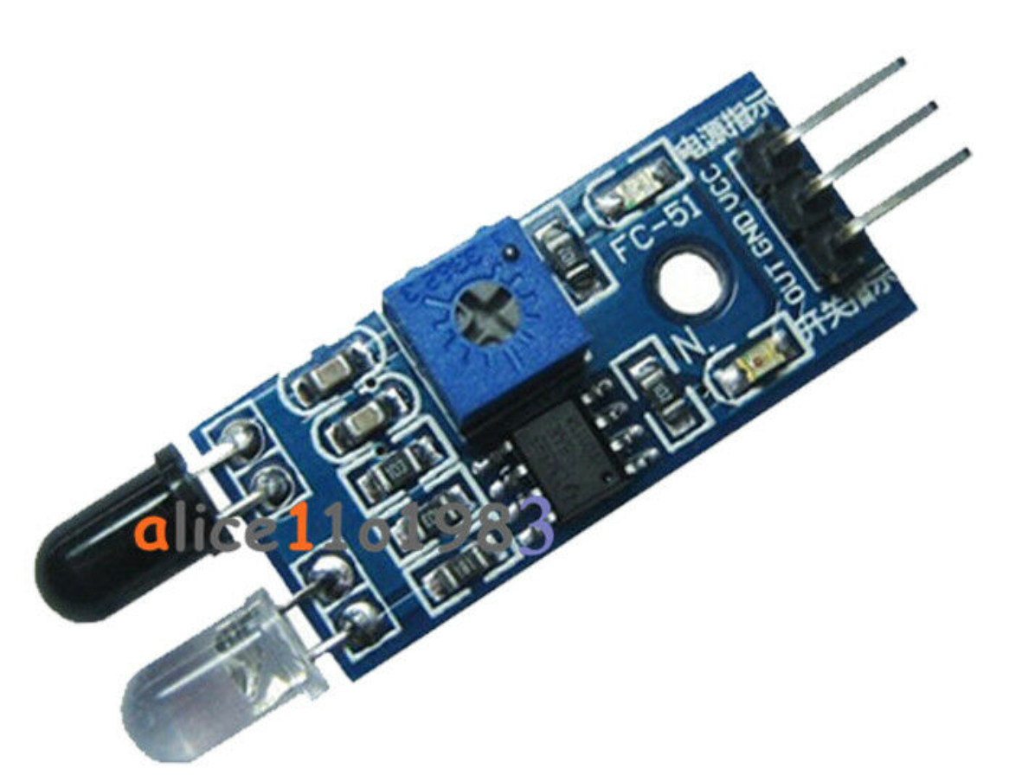
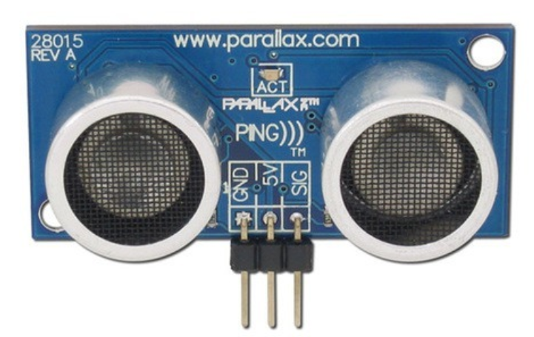
Sensor Comparison
Muhammad Khan
 | Ultrasonic | Infrared | Ping
Range | 2-400cm | 2-40 cm | 3-300cm
Cost | $1.50 | $8.95 | $29.99
Accuracy | Good | Fair | Excellent
Frequancy | 40 kHz | 353 THz | 40 kHz
Beam Pattern | Conical | Narrow Line | Narrow Angle

Slide 20
HC-SR04 Ultrasonic Sensor
Muhammad Khan
Specification
Working Current: 15mA
Working Voltage: DC 5V
Working Frequency: 40Hz
Max Range: 400cm
Min Range: 2cm
Measuring Angle: 15 degree
Trigger Input Signal: 10µS TTL pulse
Echo Output Signal Input TTL lever signal and the range in proportion
Dimension 45 * 20 * 15mm
Advantages
High sensitivity
Easy to detect external or deep object
Greater Accuracy
Low Power Consumption
Low Cost

Slide 21
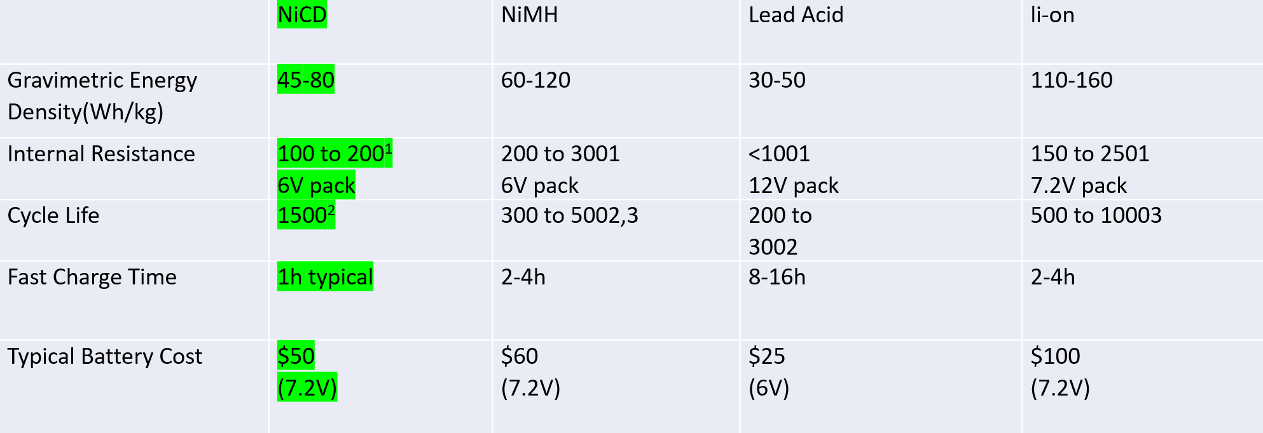
Battery
Amine Chahli
Fast and simple charge
provides over 1000 charge/discharge cycles.
Long shelf life – in any state-of-charge.
the NiCd is the lowest cost battery in terms of cost per cycle.
Available in a wide range of sizes and performance options — most NiCd cells are cylindrical.

Slide 22
Bluetooth Vs Wi-Fi
The HC-05 has an operating voltage range of 4-6 Volts and the ESP8266 has a voltage range of 3-3.6 volts. Easier to implement Bluetooth on PCB because of the 5V output since all the modules also have a 5V output and we don’t need to make a port for 3.6V output.
The ESP8266 uses 8 pins and the HC-05 uses 4 pins so the HC-05 is better for the PCB since it needs less pins.
In order for the ESP8266 to have a sufficient range it needs to have an antenna for it to boost its range, the HC-05 has a range of up to 100m without an antenna.
Programming for the HC-05 is much simpler because it does not require you to find and configure the SSID and password like the ESP8266 does.

Slide 23
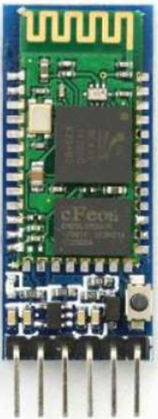
Bluetooth
Hunter Busa
This is the HC-05 Bluetooth module for the Arduino.
The purpose of this is to connect the Arduino to the mobile app and send information through it.
Plenty of online resources and tutorials that use this exact Bluetooth module.
Operating Voltage of 4 – 6 Volts with a current of 30mA.
It uses Frequency-Hopping Spread spectrum (FHSS) to send its signals.
It has a range of up to 100m.
Master/Slave mode.
This is important for sending information from the microcontroller to the phone or vice versa.
Cost effective

Slide 24
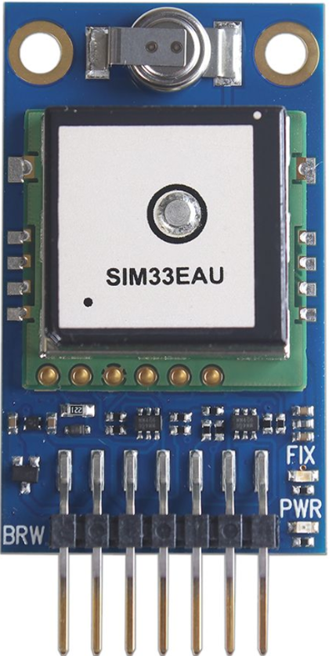
GPS Module
Hunter Busa
Specs
This is the SIM33EAU GPS Module and can be integrated with multiple boards including the Arduino.
With this module the ACA will be able to read its position on earth.
Highly accurate module that offers location fix, speed, heading, altitude, and atomic date and time
Ready for use with 3.3 V – 5 V microcontrollers with 60mA max but typically operates with 45mA.
Power and satellite fix LEDs.
Navigation update rate: up to 10 Hz.
33 tracking and 99 acquisition channels with jamming elimination.
Indoor and outdoor multi-path detection and compensation.
Speed accuracy: 0.1 meter/second.

Slide 25
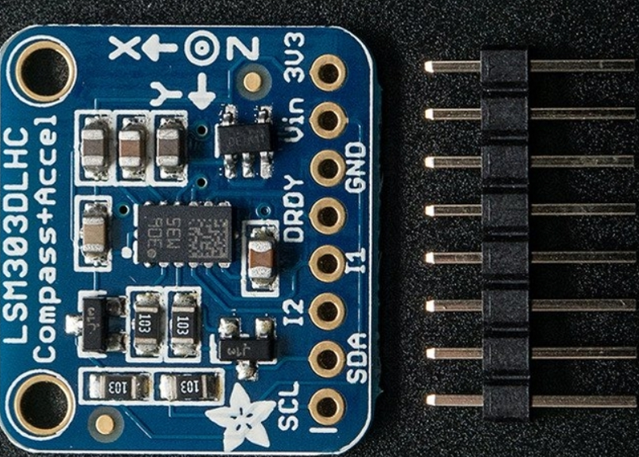
Magnetometer Compass Board
Hunter Busa
This is the Triple-axis LSM303 Magnetometer Compass Board that can be integrated with the Arduino.
Combined with the GPS Module this is how the ACA will become autonomous and follow/lead the user.
A very easy to use sensor that uses I2C to communicate.
It’s purpose is to sense magnetic north so we can orient the ACA’s position.
Specs
Ready to use with 3V or 5V microcontrollers.
Selectable power mode/resolution for accelerometer and magnetometer.
This board also has an accelerometer to detect which direct is down towards earth but we will not need to use that feature for the ACA.
16-bit data output.
3 magnetic field channels and 3 acceleration channels.
Programmable interrupt generators for freefall, motion detection and magnetic field detection.

Slide 26
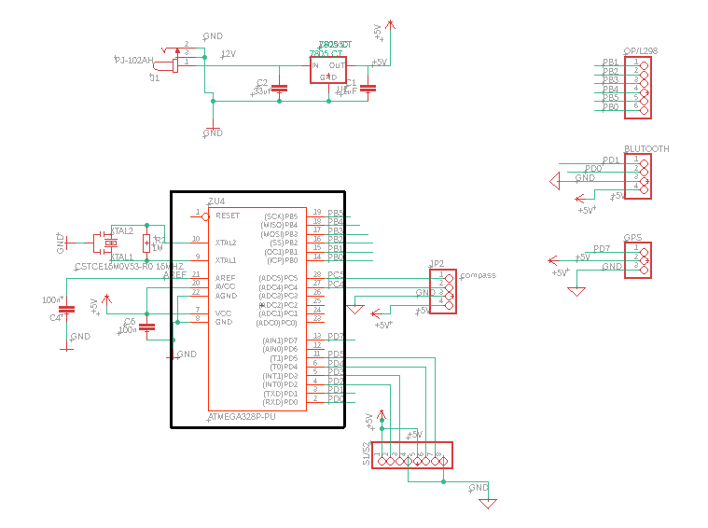
System schematic
Amine Chahli
ATmega328P-PU

Slide 27
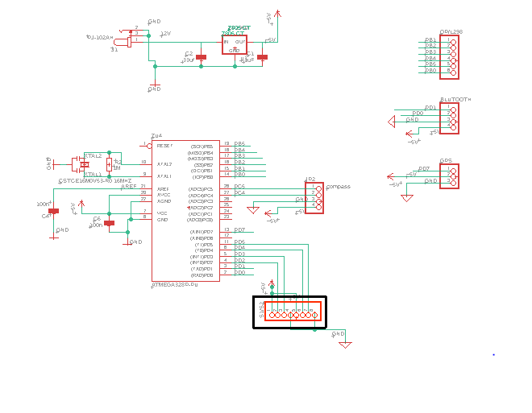
Sensors
Amine Chahli

Slide 28
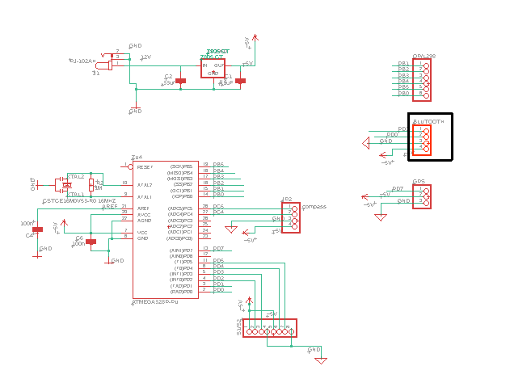
Bluetooth
Amine Chahli

Slide 29
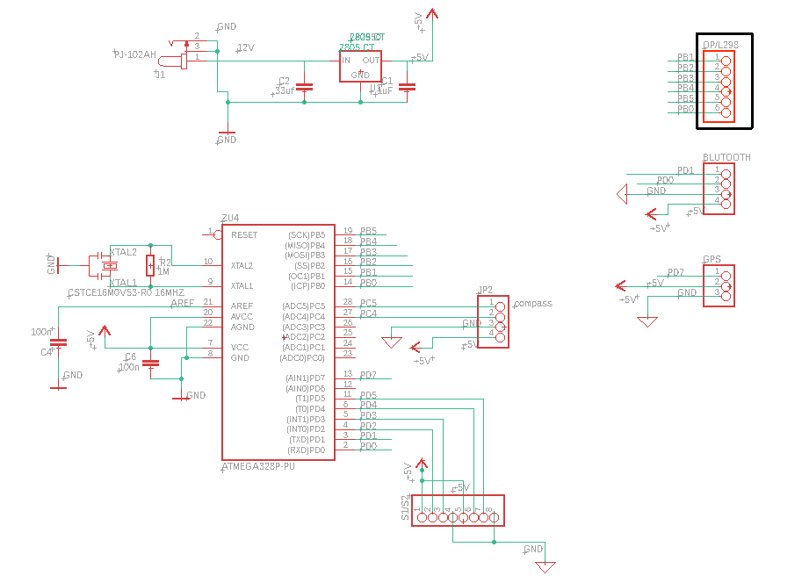
Motor Driver L298N
Amine Chahli

Slide 30
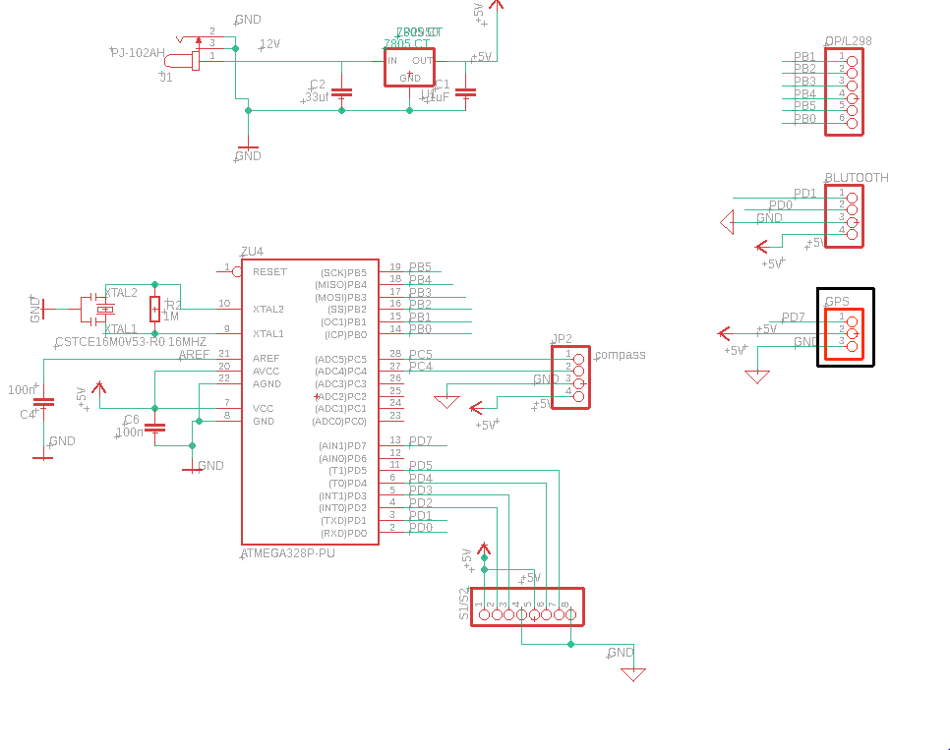
GPS
Amine Chahli

Slide 31
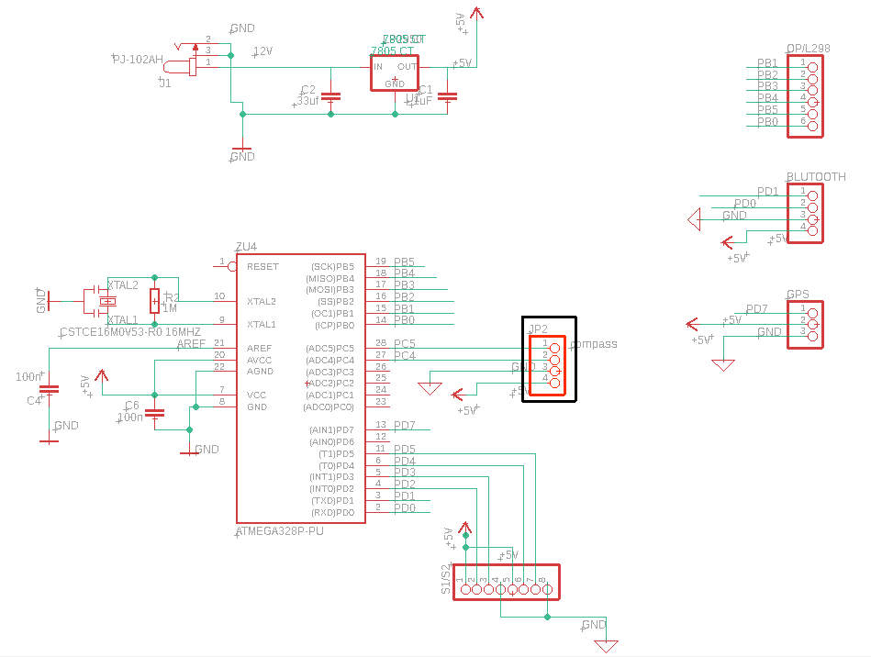
Compass
Amine Chahli

Slide 32
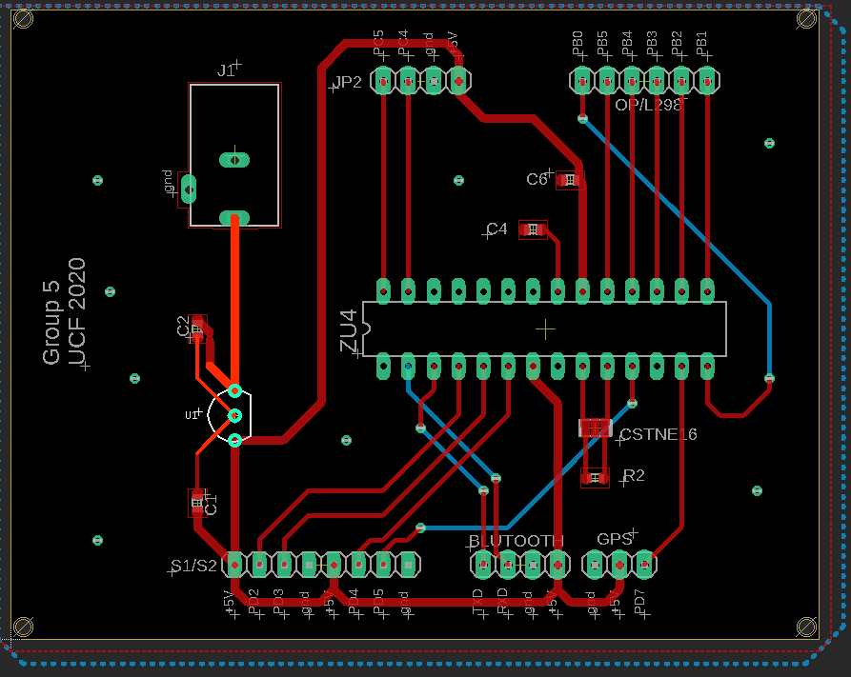
Amine Chahli
Printed Circuit Board

Slide 33
Wheels Comparison
Richard Garces
Brands | Nexus | Banebots | Andy Mark
Model | Clear PU | Colson | HiGrip Wheel Rev II
Diameter | 5.7 inches | 5 inches | 6 inches
Width | 1.18 inches | 1.25 inches | 1 inch
Tread material | Polyurethane | Thermoplastic rubber | Thermoplastic Polyurethane
Tread Type | Flat | Flat | Medium Tread
Load Capacity | 110 lbs | 100 lbs | 90 lbs
Price (2) | $9.04 | 6.03 | 24.00

Slide 34
Richard Garces
Wheel
AndyMark 6" HiGrip Rubber Wheel
Hub
Diameter gives clearance for clamps for the motors
High quality wheel provides durability on multiple terrains
6mm Set Screw Hub
Fits the Motor

Slide 35
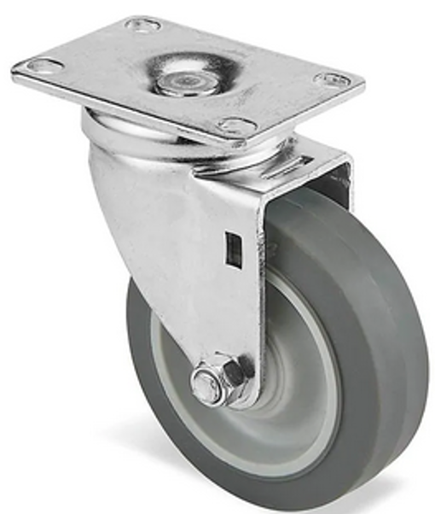
Richard Garces
Rotating/Caster Wheel
Allows for better mobility
Better for turning
Better for budget
Eliminates need for more motors
No coding needed

Slide 36
Muhammad Khan
FFinaninancial Plan
Sr # | Components | Discription/ Model | Amount | Quantity | Total Amount in | Remarks
 |  |  | in USD |  | USD
1 | Base Model | Assembly | $40.00 | 1 | $40.00 | Wood, Nut/Bolt,Glue
2 | Battery | 24 V | $34.55 | 1 | $34.55 | DC Power
3 | PCB | Printed Circuit Board | $40.00 | 2 | $80.00 | From China
4 | Voltage Regulator | DC Voltage Regulator Buck Converter | $12.90 | 1 | $12.90
5 | Tire | 4" Revolving tire | $4.99 | 1 | $4.99
6 | Tires | 6" Heavy Duty | $12.00 | 2 | $24.00 | with 2 D hubs
7 | Ultrasonic Sensor | Ultrasonic Ranging Module HC-SR04 | $1.95 | 4 | $7.80
8 | LCD Display | 1602A | $2.56 | 1 | $2.56
9 | Microcontroller | Audrino | $22.00 | 1 | $22.00 | Audrino Uno
10 | GPS Module | Navigation System | $30.00 | 1 | $30.00
11 | Resistors | Different values | 0.1 | 50 | $5.00 | Bulk
12 | Capacitors | Different values | 0.1 | 25 | $2.50
13 | Bluetooth Module | Blutooth | $7.99 | 1 | $7.99
14 | Compass Module | Direction | $15.00 | 1 | $15.00
15 | Motor | High Speed DC Motor 6-24 Volt DC | $6.95 | 2 | $13.90 | Johnson Electric
16 | Motor Driver | L298N | $5.99 | 1 | $5.99 | H-Bridge
17 | Motor Mount | Mount | $3.00 | 2 | $6.00 | Includeing nuts
18 | Battery Charger |  |  |  | $2.00
19 | Wire | 20 Feet | $8.95 | 1 | $8.95
 |  |  |  | Total | $326.13
B
U
D
G
E
T

Slide 37
Work Distribution
Muhammad Khan
Assignment | Primary | Secondary
PCB Design | Amine | Muhammad
MicroController | Richard | Amine
Battery | Amine | Muhammad
Mobile Application / GPS | Hunter | Richard
Motor / Driver | Muhammad | Amine
Assembly / Platform | Richard | Hunter
Sensor | Muhammad | Hunter
User interface | Hunter | Richard

Slide 38
Thank you!

